Slide 1
Lost = Presentation
presenters = “Dan Herfurth, Kristen Hanold, Ty Pleasant, Norman Adkins”
Print(presenters)
Dan Herfurth, Kristen Hanold, Ty Pleasant, Norman Adkins

Slide 2
Agenda
Research Questions
Data Exploration
Data Cleaning and Preparation
Analysis

Slide 3
DELETE: Current topic of interest is covid
Questions centered around individuals with pre-existing conditions
Individuals with pre-existing conditions tend to have the worst outcomes¹
We wanted to see how the pandemic, in general, had an effect on this population
Focus was more on the lifestyle choices
Because of time constraints, we wanted to specifically look at physical activity
¹ CDC COVID-19 Reporting, 10/14/2021: https://www.cdc.gov/coronavirus/2019-ncov/need-extra-precautions/people-with-medical-conditions.html

Slide 4
Research Questions
How did comorbidities affect lifestyle changes during COVID?
How education and socioeconomic status affect comorbidities?

Slide 5
Data Exploration

Slide 6
Datasets Evaluated
CDC Household Pulse Survey
Data Description: CDC Household Pulse Survey
Benefit: Across phases of the pandemic and easy to work with
Limitation: Only a few questions to work with.
University of Iowa
Data Description: Google Trends Data
Problem 1: There appeared to be assumptions made with the data.
Problem 2: Hard to really make conclusions off of trends when more people are just at home
Stanford University
Data Description: Pre-pandemic and during pandemic survey data
Benefit: Includes questions that identify conditions and habits
Benefit: A large survey sample, even after data cleansing.

Slide 7
About the Stanford Data
Survey Study Data on Lifestyle Changes during COVID-19 Pandemic
Raw Data Published and openly accessible
Scientific validity as a scientific manuscript depended on this data.
A larger set of sample data (2,055 completed surveys)
Discrete data vs. continuous.
Same survey multiple times = consistent data collection.
Downside: Data had to be cross-referenced as numerical value assignments did not follow best practices.

Slide 8
Data Cleaning Process
https://github.com/nladkins/Project-1-EDA

Slide 9
Cleaning the Data
Timestamps were in the survey identifying what sections were completed
Filtered out any row with missing timestamps
Due to remaining size of responses, filtered down to US responses only
Changed numbers to align with best practices (“0” = “No”, “1” = “Yes”)
Health conditions used 4 responses (SEE NEXT SLIDE):
”Yes”
“No”
“Not aware of the term”
“Prefer to not answer”
Column inserted to reference to identify whether they were found to have no comorbidities vs. having them.

Slide 10
Cleaning the Data (continued)
No Preexisting Conditions
Preexisting Condition Criteria
Had to answer “Yes” to any one of the conditions regardless of other responses.
Rationale: Clear that there is at least one pre-existing condition
Had to answer “No” to ALL conditions.
Rationale: Clear that they fully understood and choose to answer the questions and selected No for all.

Slide 11
Demographics

Slide 12
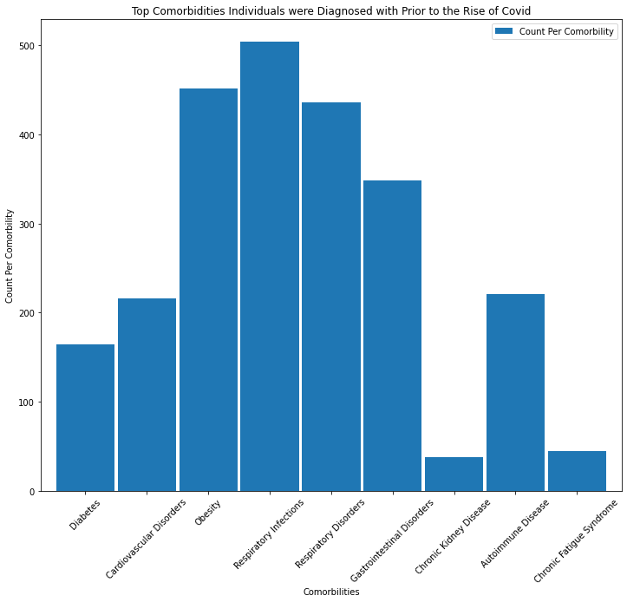
Top Comorbidities

Slide 13
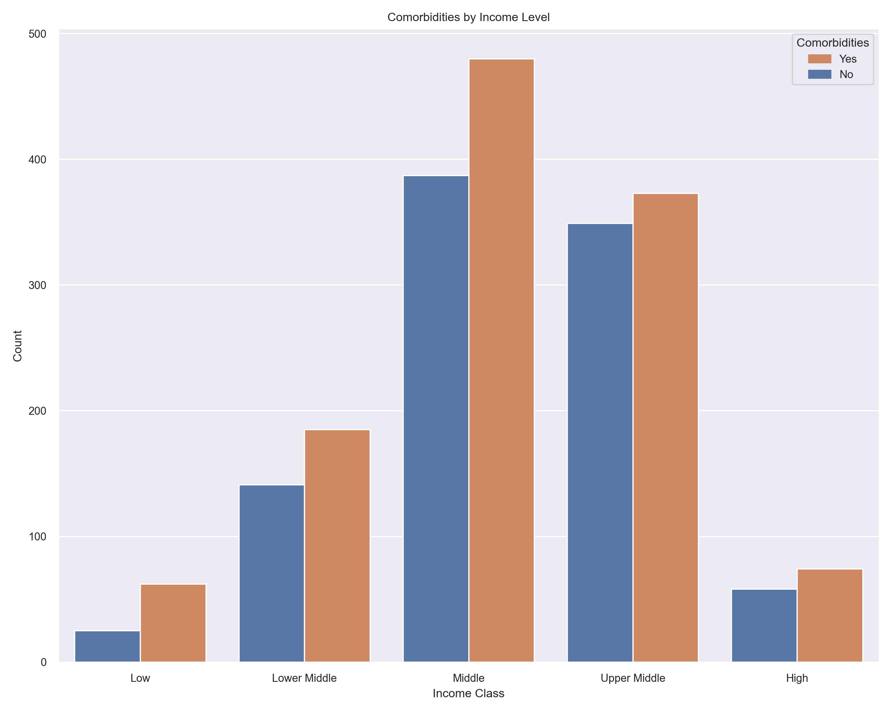

Slide 14
Findings/Analysis

Slide 15
Percentage of people with n-comorbidities

Slide 16
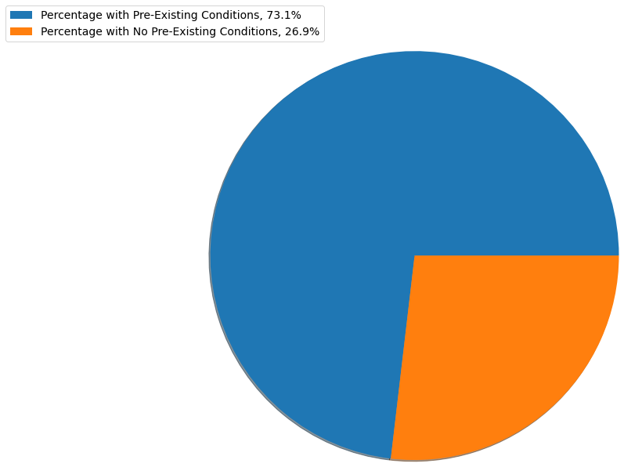
Percentage of participants with and without comorbidities

Slide 17
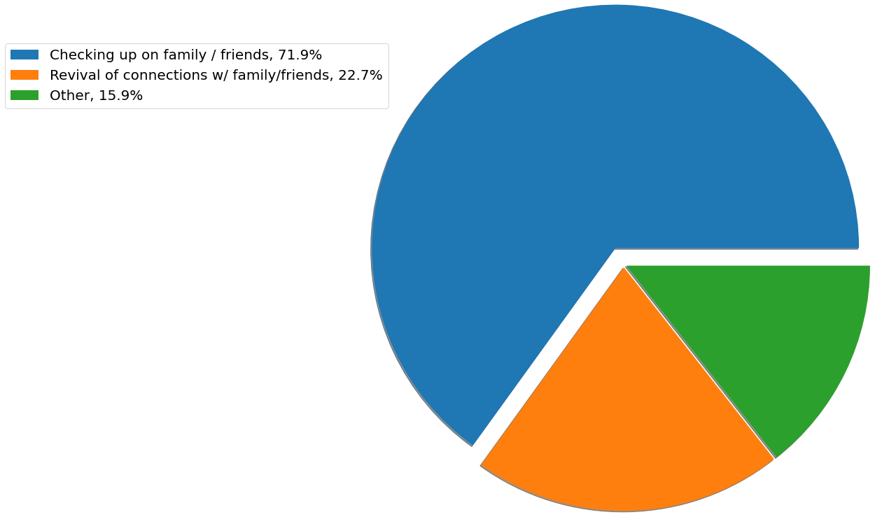
Social Changes made during COVID-19

Slide 18
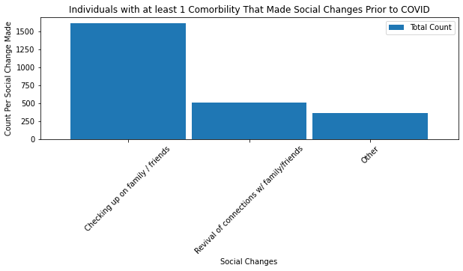
Individuals with comorbidities that made social changes

Slide 19
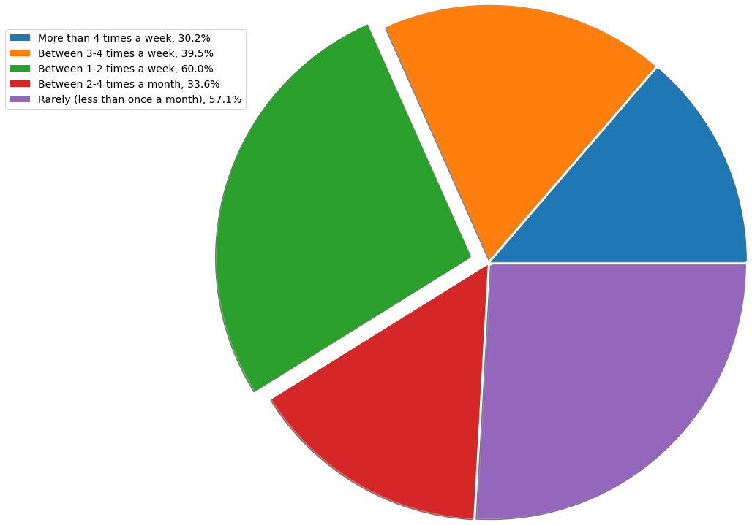

Slide 20
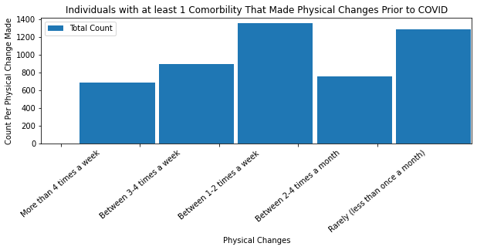

Slide 21
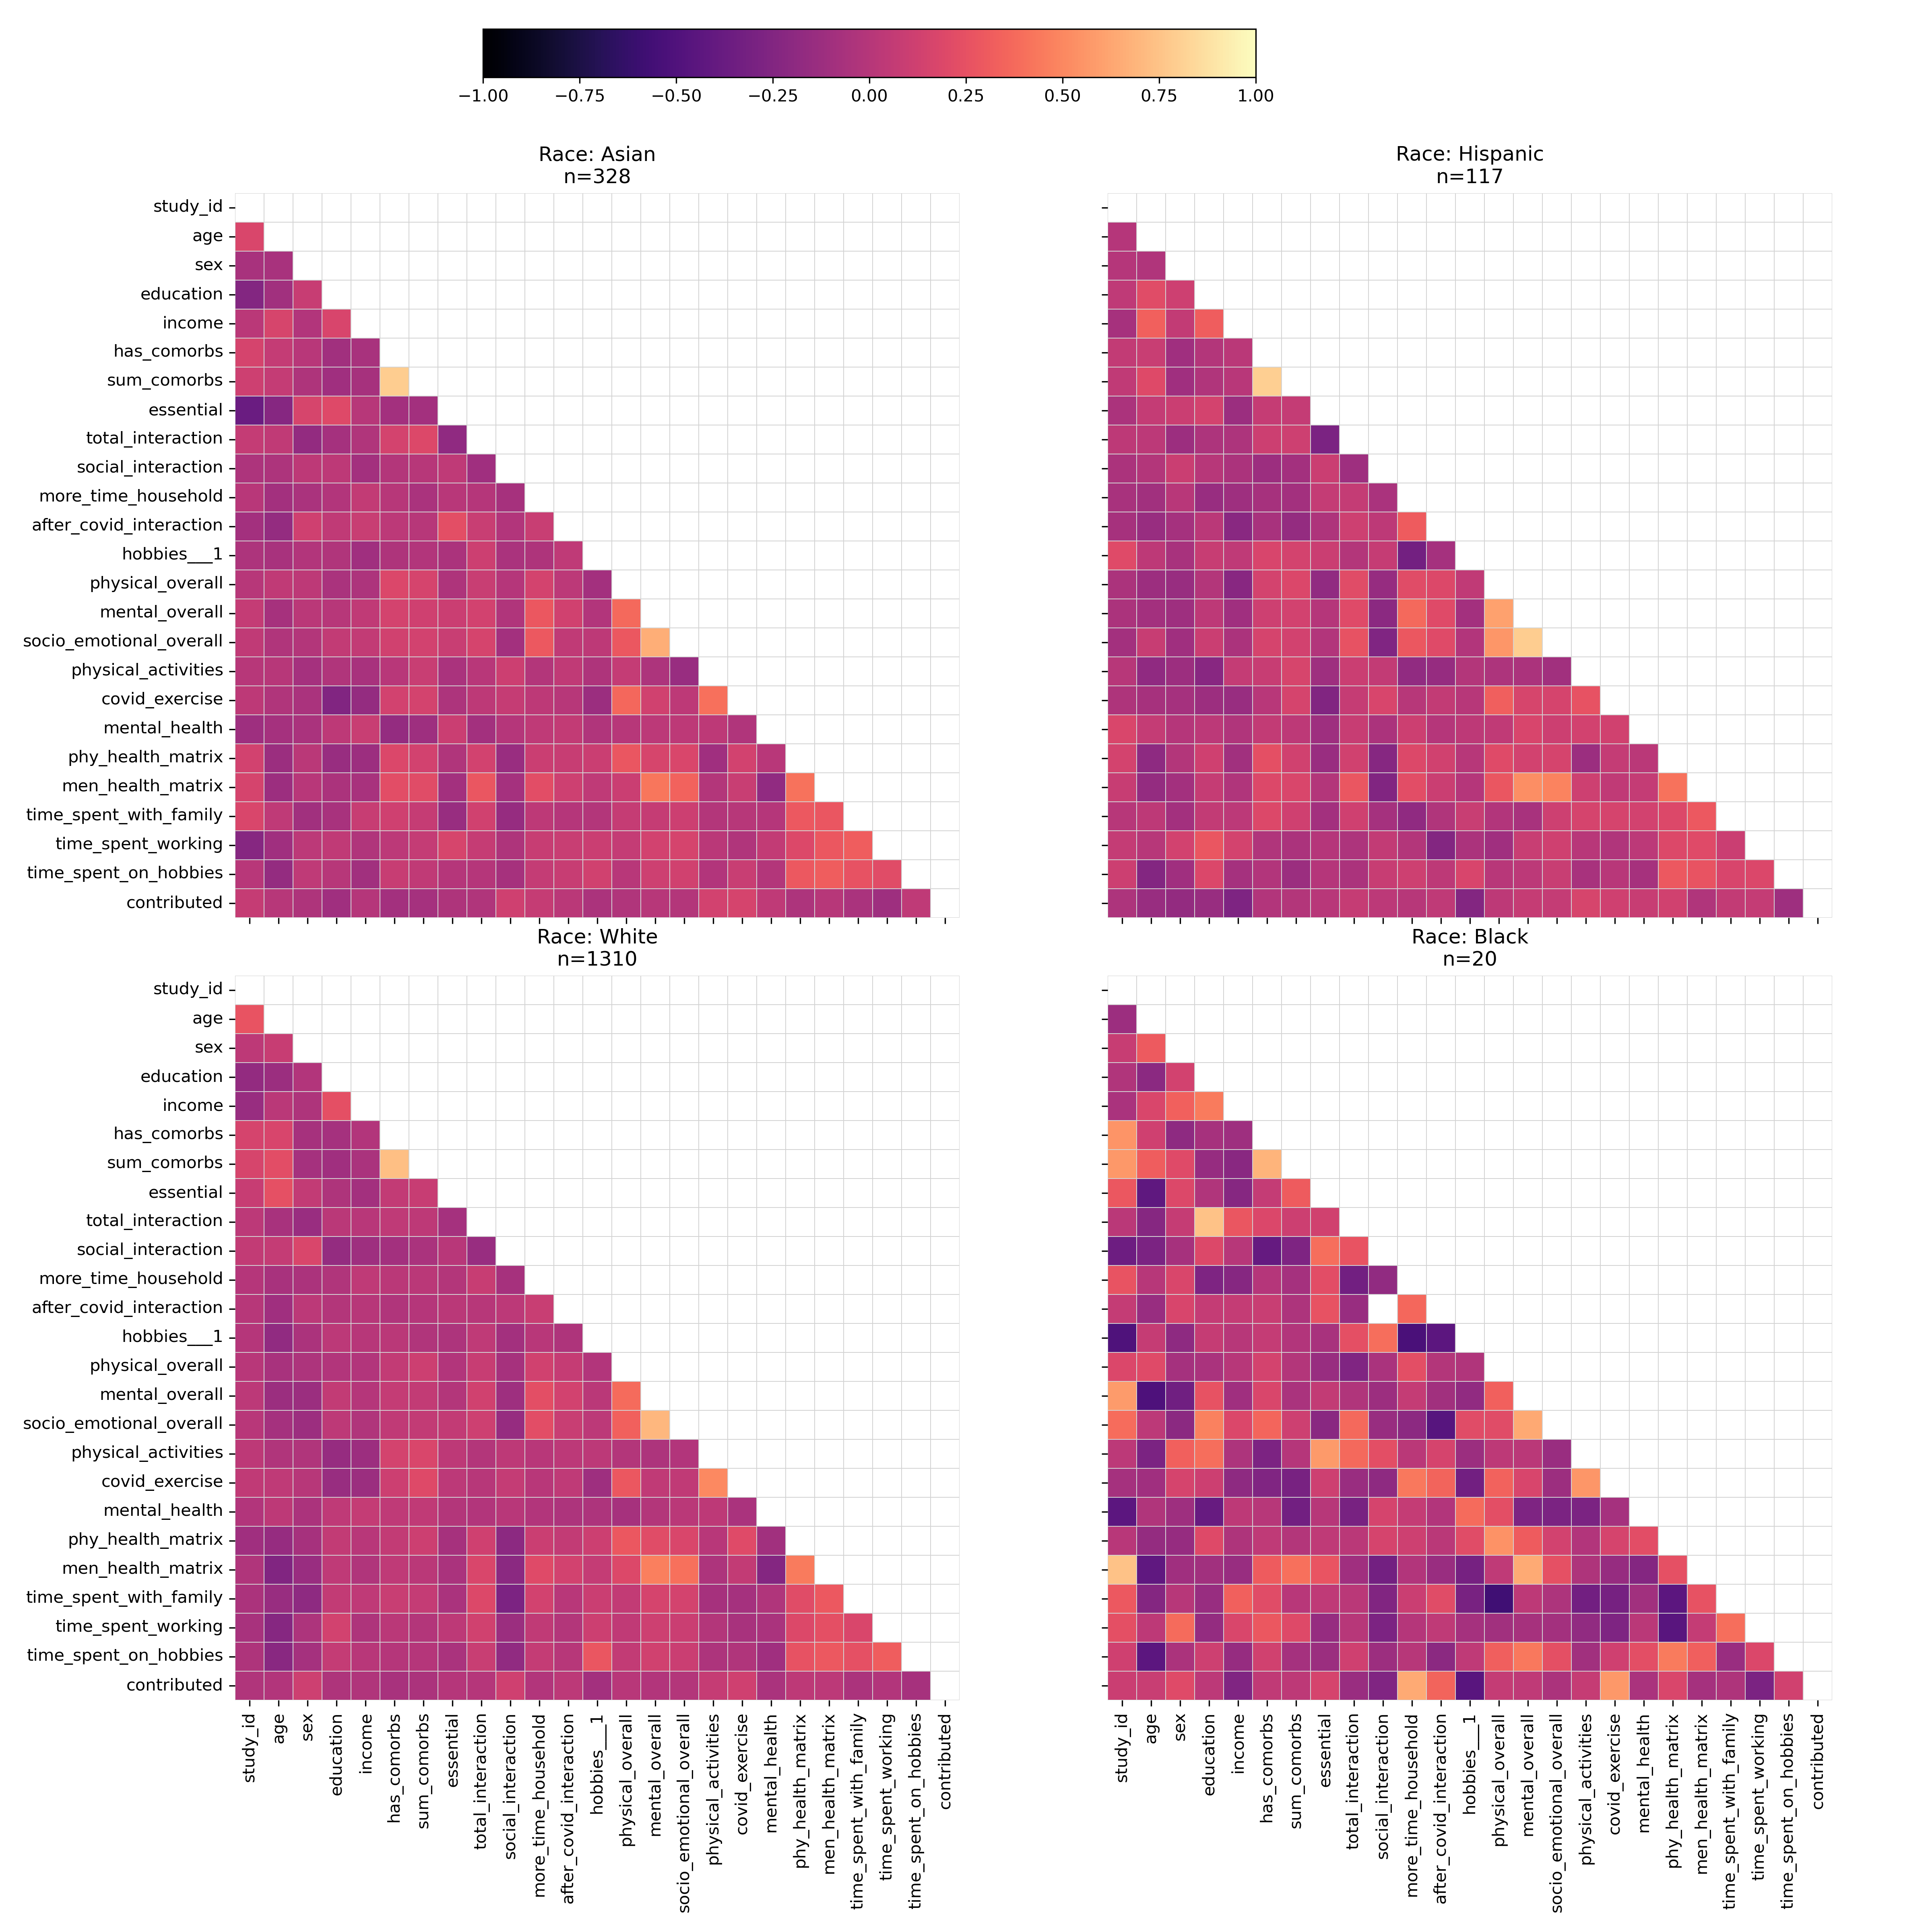

Slide 22
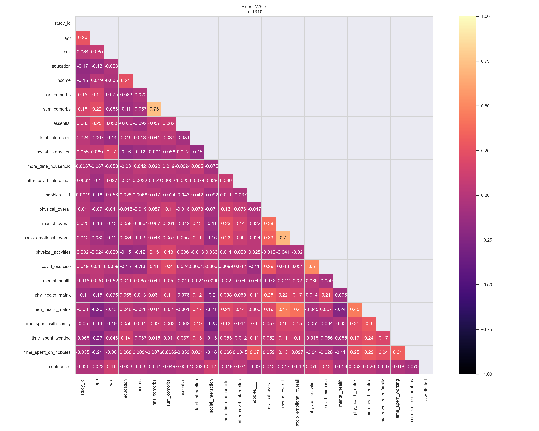

Slide 23
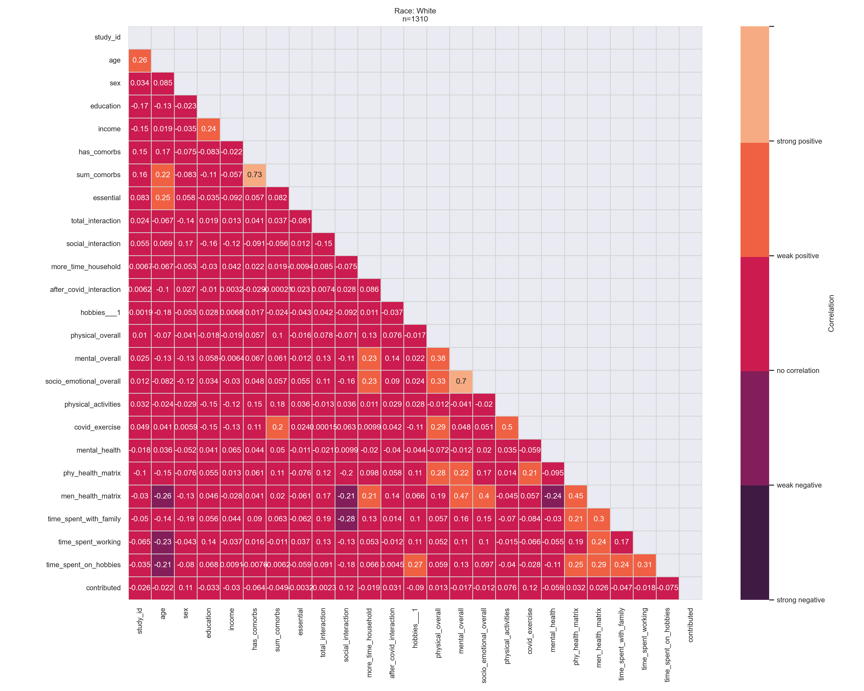

Slide 24
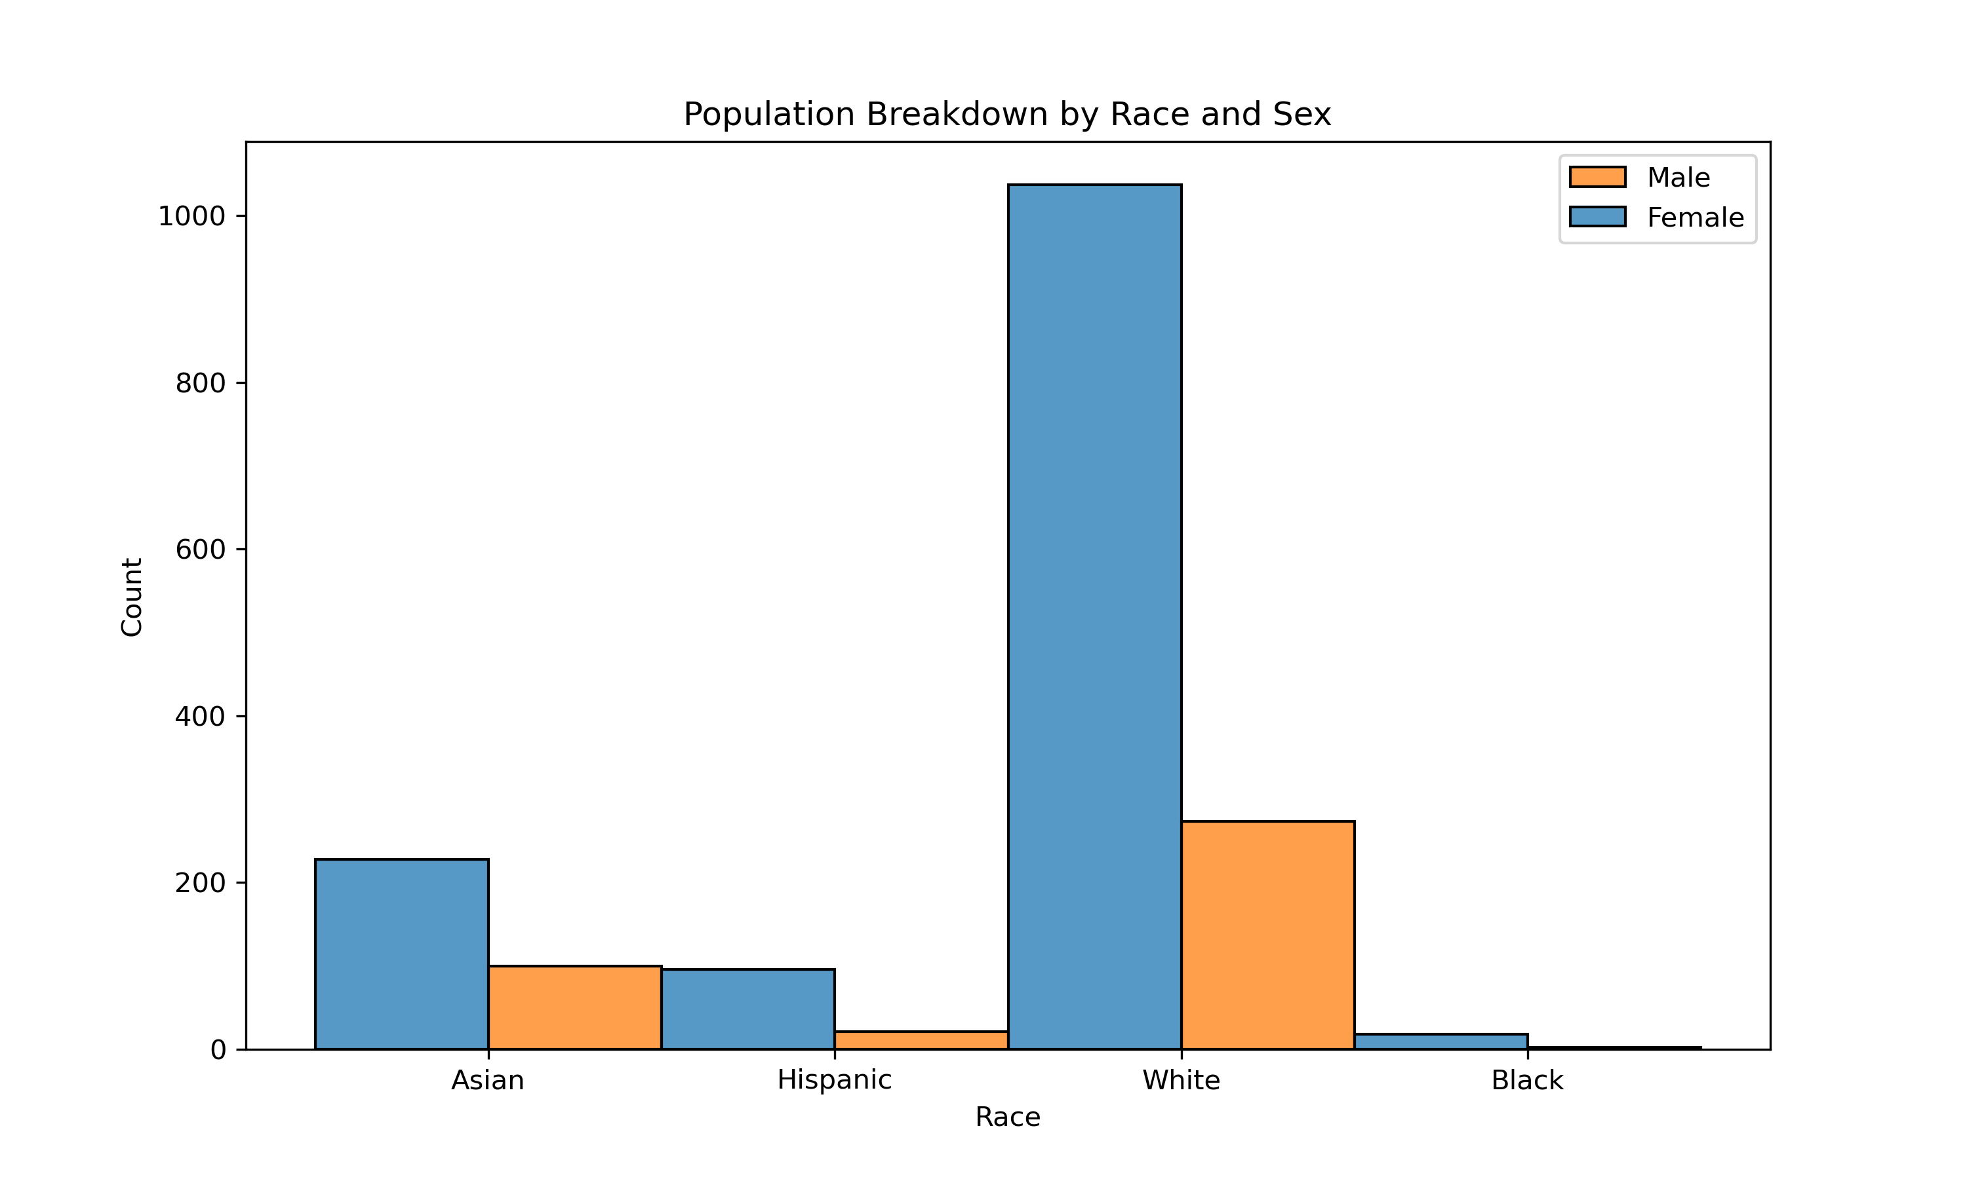

Slide 25
